Slide 1


CS106A: Programming Methodologies

Slide 2
Chris Piech
My parents are interesting folks
I originally concentrated in graphics and worked at Pixar
Childhood: Nairobi, Kenya
High School: Kuala Lumpur, Malaysia
Stanford University Ph.D. in Neural Networks
Research lab on AI for Social Good
The problem I really want to solve is to make high quality education more accessible

Slide 3
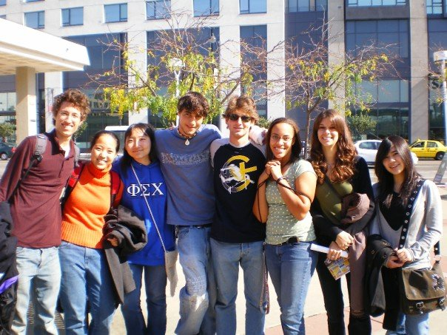
Chris Piech
12 years ago to this day, I was sitting in your seats

Slide 4
Head TA: Brahm Capoor

Slide 5
Section Leaders
* Actually last year’s section leaders

Slide 6
Course mechanics
(this is a light version. Please read the handout for details).

Slide 7
Course Website
http://cs106a.stanford.edu

Slide 8
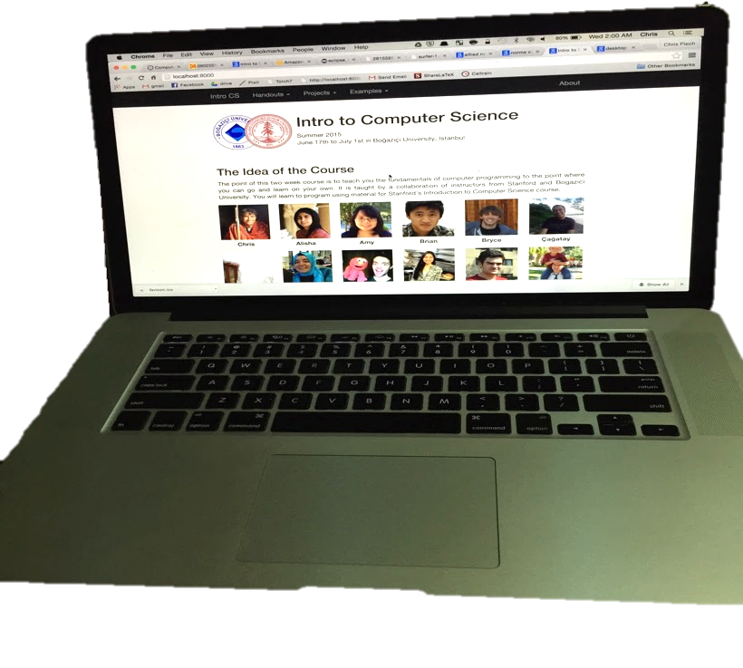

Prerequisite Test

Slide 9
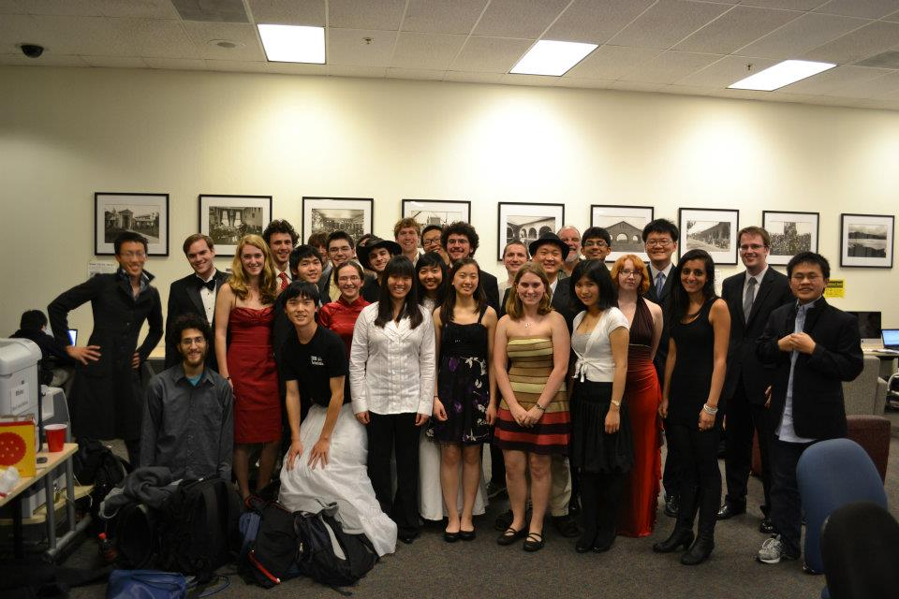
Lectures and Sections
Weekly 50-min section led by awesome section leaders (the backbone of the class!)
Signups begin on Thursday at 5:00pm and close Sunday at 5:00pm

Slide 10
Office Hours
LaIR: evenings Sunday through Thursday
(starting next Sunday)

Slide 11


Grading Scale
Functionality and style grades for the assignments use the following scale:
A submission so good it “makes you weep.”
Exceeds requirements.
Satisfies all requirements of the assignment.
Meets most requirements, but with some problems.
Has more serious problems.
Is even worse than that.
Better than nothing.

Slide 12
Interactive Grading
One on one feedback from your section leader

Slide 13
What we will ask you to do
*Two free late days

Slide 14
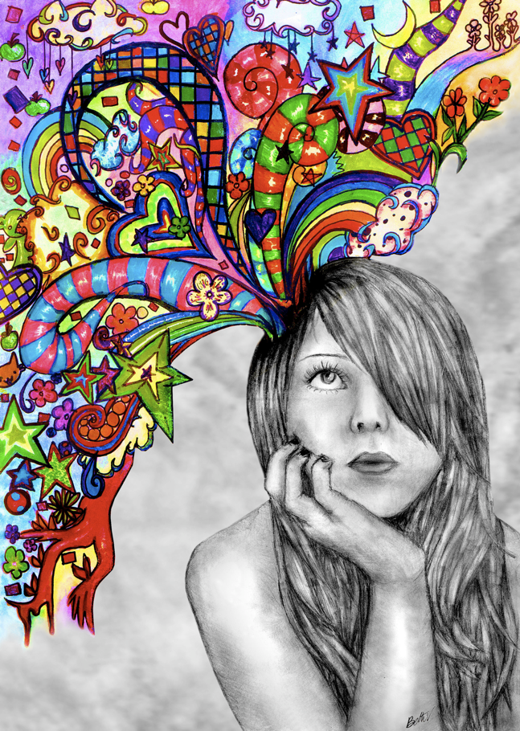
Optional Contest

Slide 15
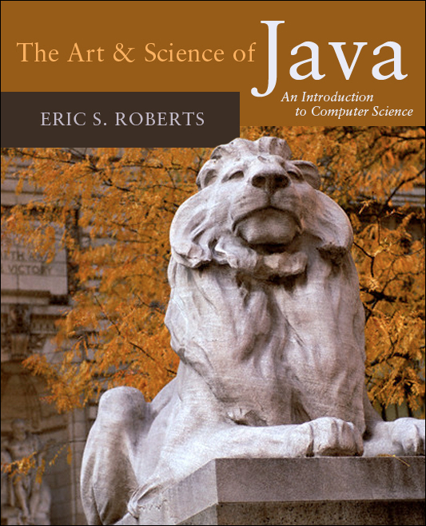
Textbook
The Art & Science of Java by Eric Roberts
written here at Stanford
tailored to this course
a valuable reference
usable on open-book exams
Karel the Robot Learns Java
First week of material

Slide 16
Online Karel Reader

Slide 17
Online Karel Reader

Slide 18
CS106A Units
Start Here
Average about 10 hours / week for assignments
Are you an
undergrad or
SCPD
student?
Do you want
to take CS106A for
fewer units?
No
Yes
3 Units
-or-
4 Units
Yes
No
5 Units

Slide 19
Are you in the right place?

Slide 20
What is CS106A?

Slide 21
Computer Science
Computer science is no more about computers than astronomy is about telescopes, biology is about microscopes or chemistry is about beakers and test tubes. Science is not about tools, it is about how we use them and what we find out when we do.
- Michael Fellows and Ian Parberry

Slide 22
Learning Goals
Learn how to harness computing power to solve problems.
To that end:
Explore fundamental techniques in computer programming.
Develop good software engineering style.
Gain familiarity with the Java programming language.

Slide 23
There are a lot of cool programs you may one day write

Slide 24
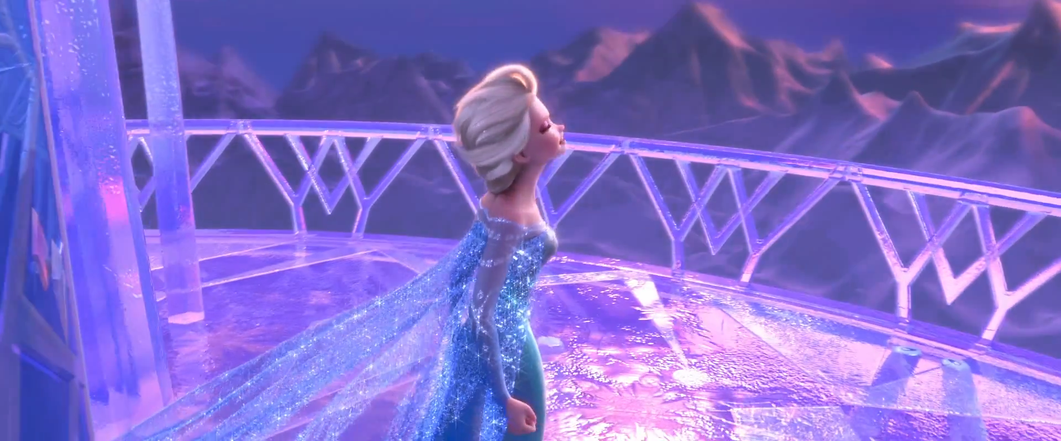
Computer Graphics
Pat Hanrahan, one of the founders of Pixar is a professor here

Slide 25
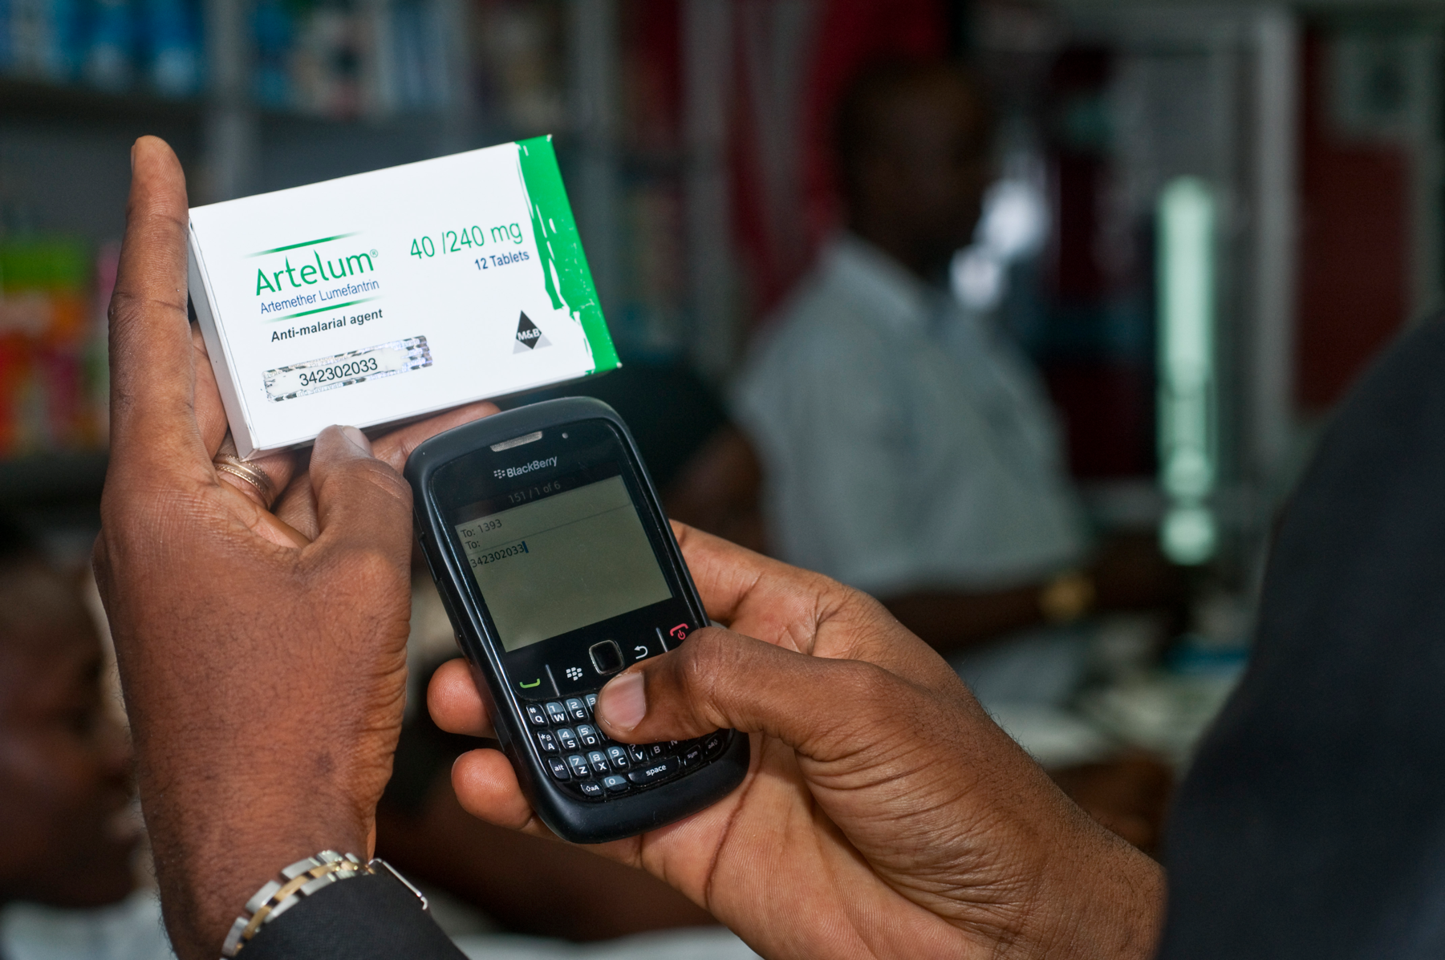
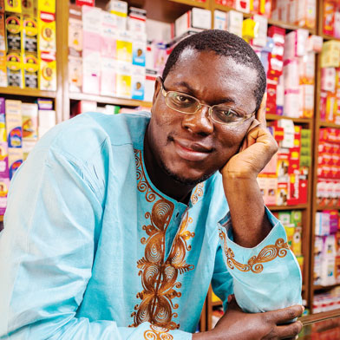
Consumer Applications
Notes:
Estimated 700,000 deaths from fame malaria and TB drugs in 2013:
http://www.un.org/africarenewal/magazine/may-2013/counterfeit-drugs-raise-africa%E2%80%99s-temperature
Bright Simmons from Ghana made an application which let people verify if their medication was authentic

Slide 26
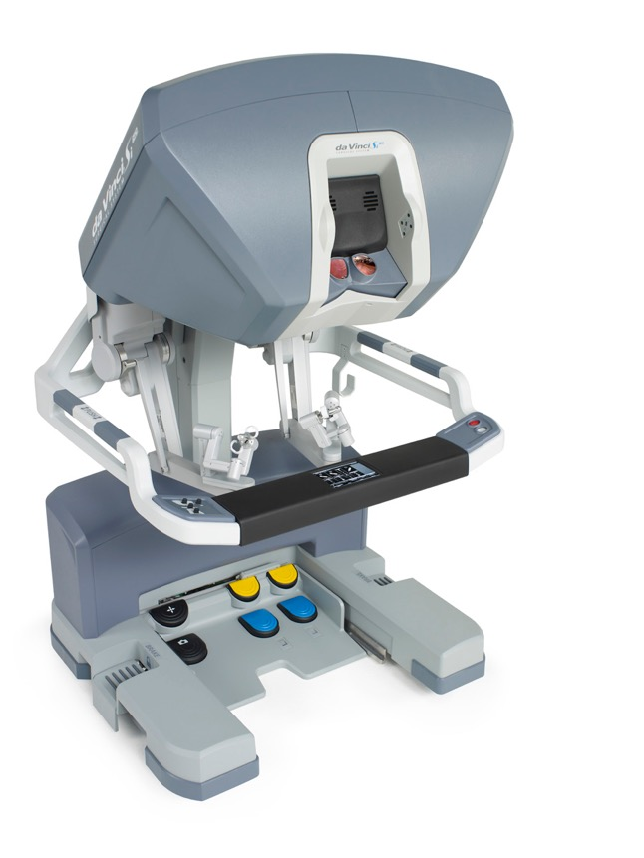
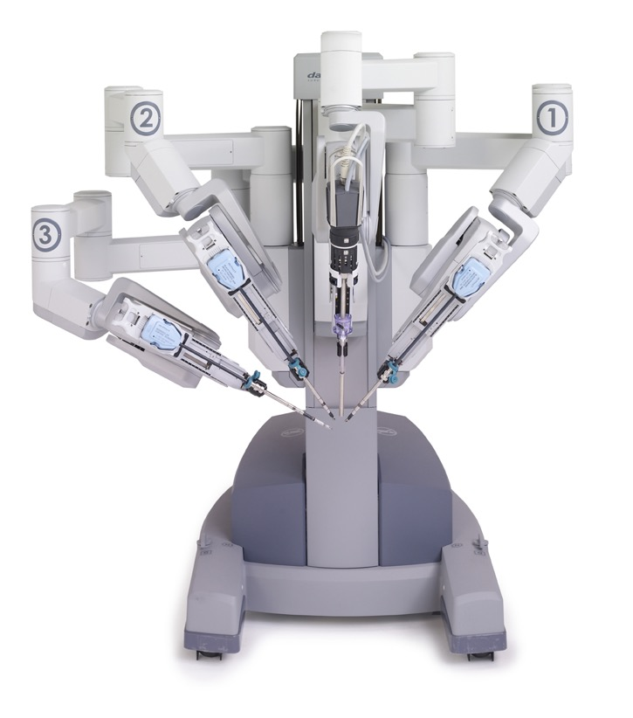
Autonomous Surgery
(c) 2012 Intuitive Surgical, Inc.

Slide 27
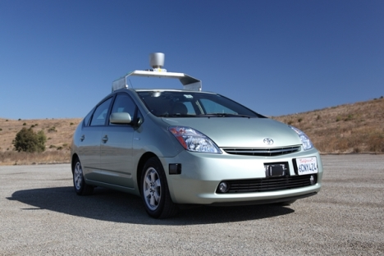
Self Driving Car

Slide 28
If only we could program self driving cars…

Slide 29
Graphical Games

Slide 30
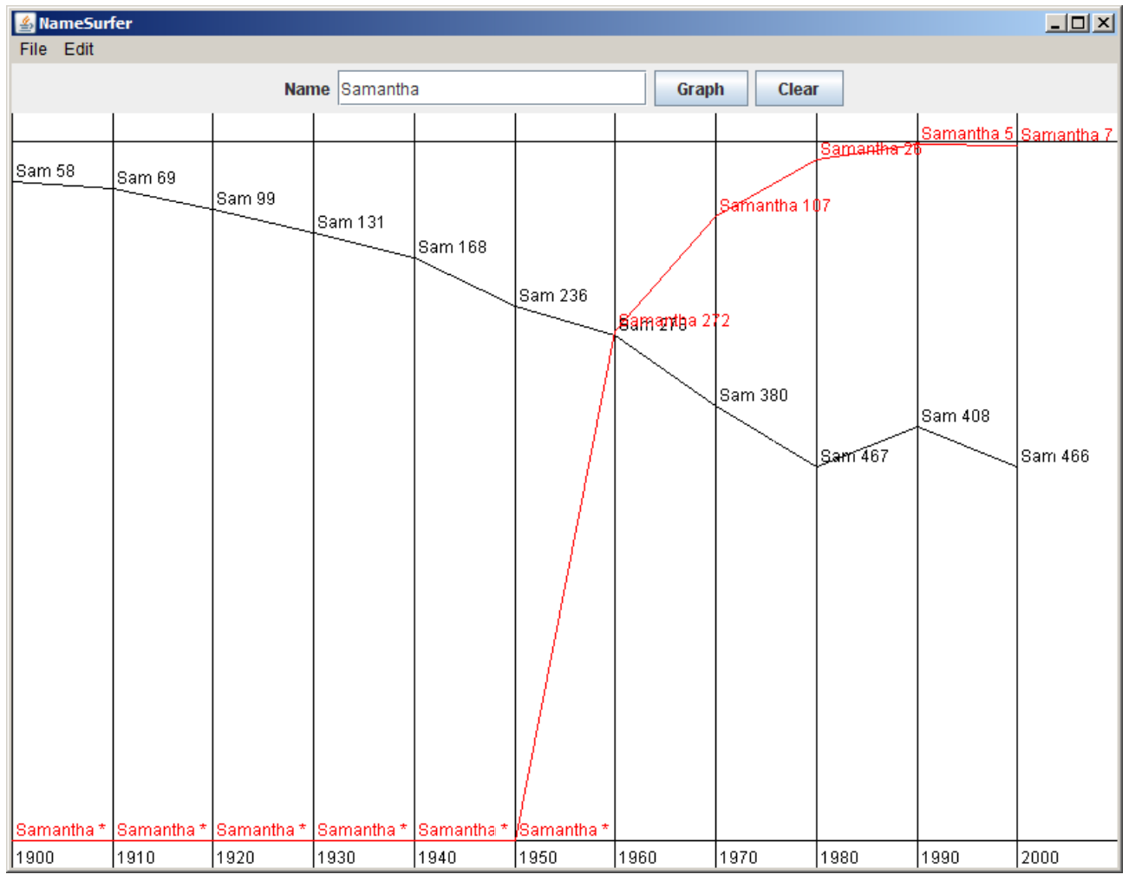
Data Visualization

Slide 31
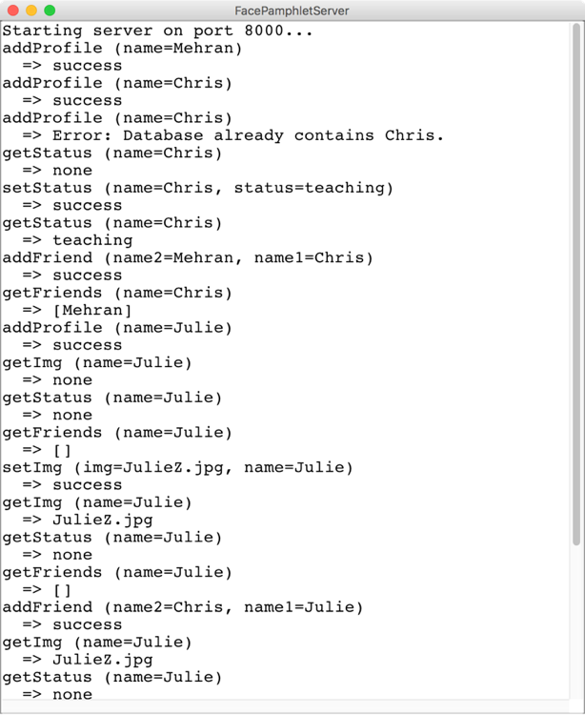
Internet Applications

Slide 32
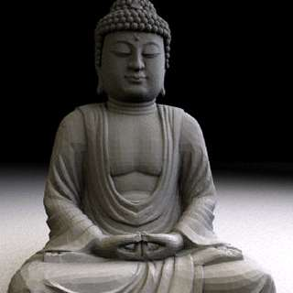
Art of Computer Science
Notes:
We teach software engineering principles. Much larger than just programming.
Mechanics of the language are nothing compared to the principles.
You are going to learn the principles by programming in Java

Slide 33
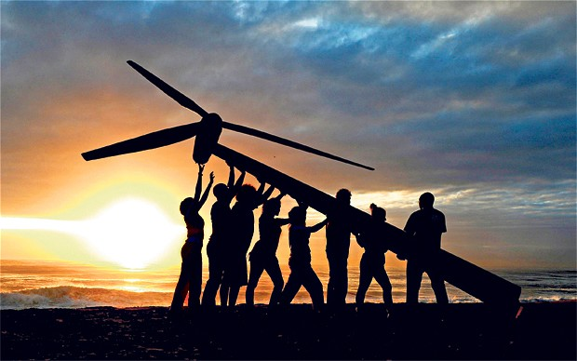
Strive for Everyone to Succeed
Notes:
We want all of you to be successful
That’s why we have such a large course staff
And its not like it’s a ya-ya course where we all hold hands and sing koombaya. Its real material.
But over years and years and years we have been working on our material so that everyone gets through…
Not competing against anyone but yourself

Slide 34
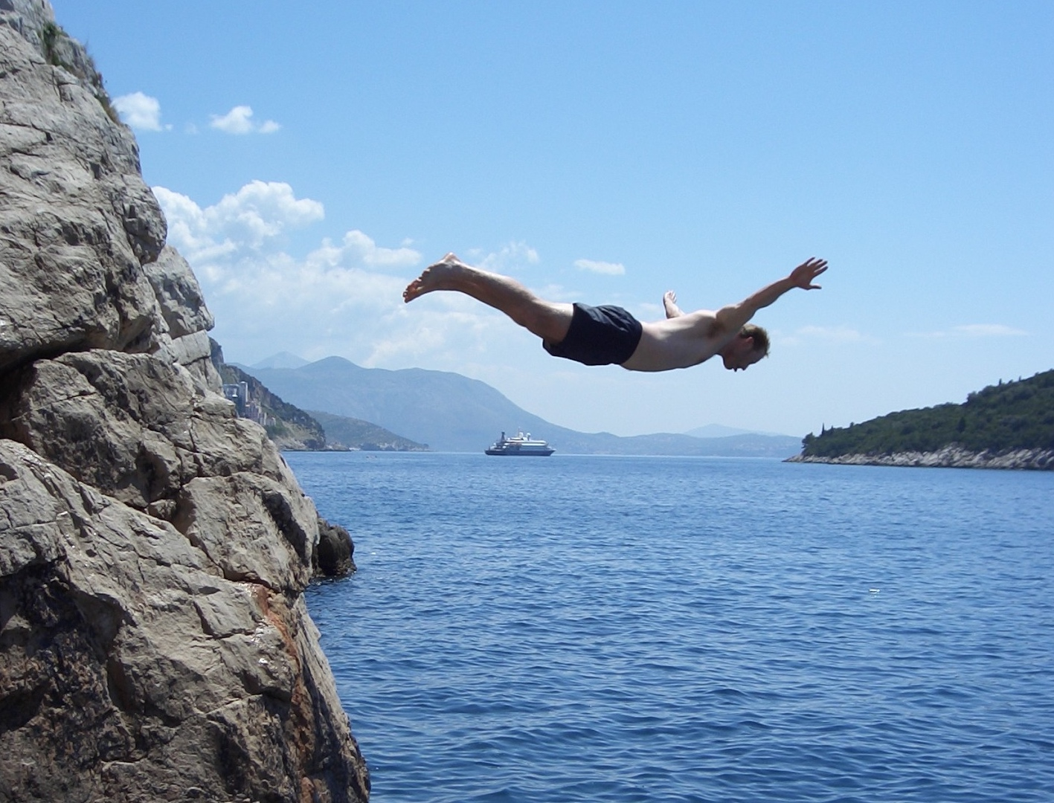
Lets Get Started

Slide 35
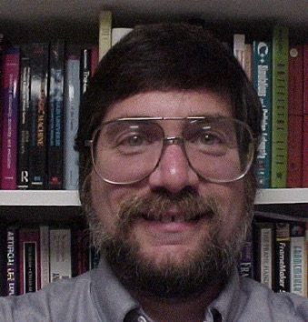

Meet Karel the Robot
Good morning
Notes:
He looks like an old machintosh machine.
Hes got legs… one sticks out the back. That’s just the way it is.

Slide 36

Karel Speaks Java
s
Notes:
Tomorrow you will learn that Karel is actually a very gentle introduction to programming

Slide 37
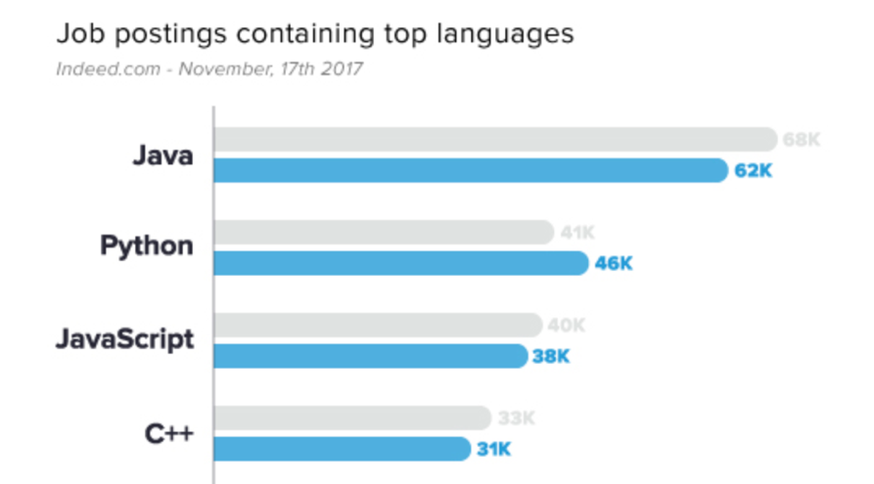
Why Java?
1
2
http://www.codingdojo.com/blog/7-most-in-demand-programming-languages-of-2018/

Slide 38


Karel’s World
North
3
+
+
+
+
+
2
+
+
+
+
+
West
East
1
+
+
+
+
+
South
1
2
3
4
5
Notes:
To you it might not be exciting but to karel its very exciting.

Slide 39
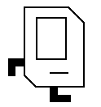
Walls
3
+
+
+
+
+
2
+
+
+
+
+
1
+
+
+
+
+
1
2
3
4
5

Slide 40

Beepers
3
+
+
+
+
+
2
+
+
+
+
+
1
+
+
+
+
+
1
2
3
4
5

Slide 41
Knows Four Commands
move();
turnLeft();
putBeeper();
pickBeeper();
Notes:
Tomorrow you will learn that Karel is actually a very gentle introduction to programming

Slide 42
move();

Slide 43
move();
3
+
+
+
+
+
2
+
+
+
+
+
1
+
+
+
+
+
1
2
3
4
5

Slide 44

move();
3
+
+
+
+
+
2
+
+
+
+
+
1
+
+
+
+
+
1
2
3
4
5

Slide 45
turnLeft();

Slide 46
turnLeft();
3
+
+
+
+
+
2
+
+
+
+
+
1
+
+
+
+
+
1
2
3
4
5

Slide 47
turnLeft();
3
+
+
+
+
+
2
+
+
+
+
+
1
+
+
+
+
+
1
2
3
4
5

Slide 48
pickBeeper();

Slide 49
turnLeft();
3
+
+
+
+
+
2
+
+
+
+
+
1
+
+
+
+
+
1
2
3
4
5

Slide 50
turnLeft();
3
+
+
+
+
+
2
+
+
+
+
+
1
+
+
+
+
+
1
2
3
4
5

Slide 51
Make Sense?

Slide 52
First Challenge
3
+
+
+
+
+
2
+
+
+
+
+
1
+
+
+
+
+
1
2
3
4
5

Slide 53
First Challenge
3
+
+
+
+
+
2
+
+
+
+
+
1
+
+
+
+
+
1
2
3
4
5

Slide 54
Bird’s Eye View
3
+
+
+
+
+
2
+
+
+
+
+
1
+
+
+
+
+
1
2
3
4
5

Slide 55
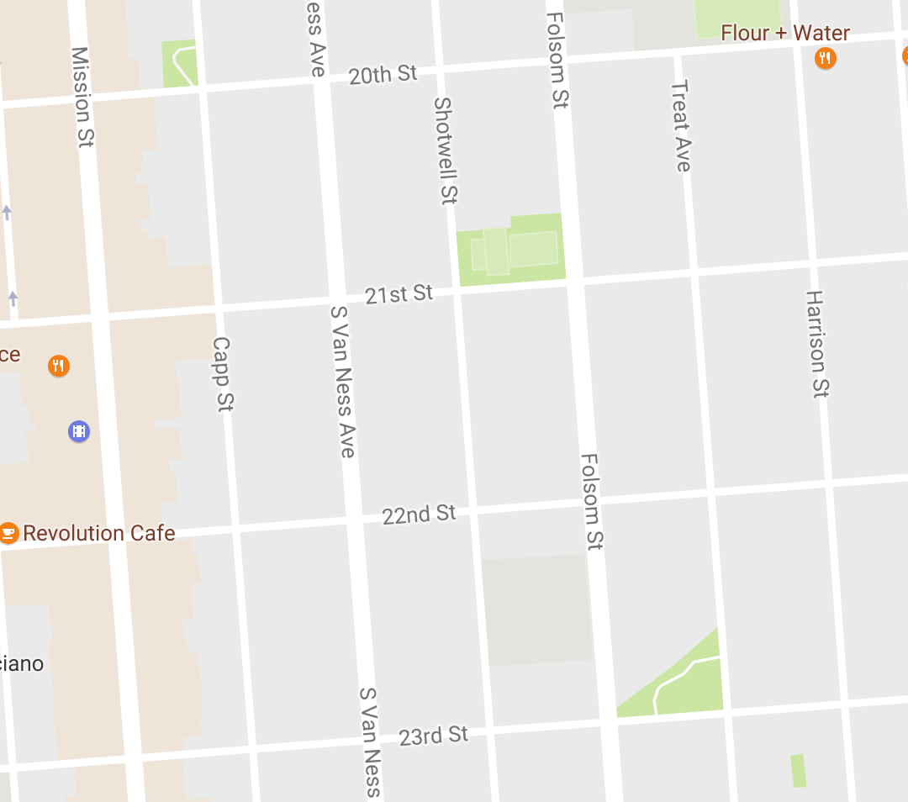
Bird’s Eye View
Karel is facing East

Slide 56
Turn Left
Karel is facing North

Slide 57
Turn Left
Karel is facing West

Slide 58
Turn Left
Karel is facing South

Slide 59
Move

Slide 60
First Challenge
3
+
+
+
+
+
2
+
+
+
+
+
1
+
+
+
+
+
1
2
3
4
5

Slide 61
First Challenge
3
+
+
+
+
+
2
+
+
+
+
+
1
+
+
+
+
+
1
2
3
4
5

Slide 62

Learn By Doing

Slide 63


Slide 64
Method Definition
private void name() {
method statements
}
This adds a new command to Karels vocabulary

Slide 65
Anatomy of a Program
Import Packages
Program

Slide 66
Anatomy of a Program
Import Packages
public class OurKarelProgram extends Karel {
}

Slide 67
Anatomy of a Program
Import Packages
public class OurKarelProgram extends Karel {
}
run method
helper methods

Slide 68
Anatomy of a Program
Import Packages
public class OurKarelProgram extends Karel {
}
public void run() {
move();
pickBeeper();
move();
turnLeft();
move();
turnRight();
move();
putBeeper();
move();
}
helper methods

Slide 69
Anatomy of a Program
Import Packages
public class OurKarelProgram extends Karel {
}
public void run() {
move();
pickBeeper();
move();
turnLeft();
move();
turnRight();
move();
putBeeper();
move();
}
private void turnRight() {
turnLeft();
turnLeft();
turnLeft();
}

Slide 70
Anatomy of a Program
import stanford.karel.*;
public class OurKarelProgram extends Karel {
}
public void run() {
move();
pickBeeper();
move();
turnLeft();
move();
turnRight();
move();
putBeeper();
move();
}
private void turnRight() {
turnLeft();
turnLeft();
turnLeft();
}

Slide 71
Anatomy of a Program
import stanford.karel.*;
public class OurKarelProgram extends Karel {
}
public void run() {
move();
pickBeeper();
move();
turnLeft();
move();
turnRight();
move();
putBeeper();
move();
}
This piece of the program's source code is called a method.
private void turnRight() {
turnLeft();
turnLeft();
turnLeft();
}

Slide 72
Anatomy of a Program
import stanford.karel.*;
public class OurKarelProgram extends Karel {
}
public void run() {
move();
pickBeeper();
move();
turnLeft();
move();
turnRight();
move();
putBeeper();
move();
}
x
This line of code gives the name of the method
(here, run)
private void turnRight() {
turnLeft();
turnLeft();
turnLeft();
}

Slide 73
Anatomy of a Program
import stanford.karel.*;
public class OurKarelProgram extends Karel {
}
public void run() {
move();
pickBeeper();
move();
turnLeft();
move();
turnRight();
move();
putBeeper();
move();
}
This line of code gives the name of the method
(here, turnRight)
private void turnRight() {
turnLeft();
turnLeft();
turnLeft();
}

Slide 74
Anatomy of a Program
import stanford.karel.*;
public class OurKarelProgram extends Karel {
}
public void run() {
move();
pickBeeper();
move();
turnLeft();
move();
turnRight();
move();
putBeeper();
move();
}
This is called a code block
private void turnRight() {
turnLeft();
turnLeft();
turnLeft();
}

Slide 75
Anatomy of a Program
import stanford.karel.*;
public class OurKarelProgram extends Karel {
}
public void run() {
move();
pickBeeper();
move();
turnLeft();
move();
turnRight();
move();
putBeeper();
move();
}
This is called a code block
private void turnRight() {
turnLeft();
turnLeft();
turnLeft();
}

Slide 76
Anatomy of a Program
import stanford.karel.*;
public class OurKarelProgram extends Karel {
}
public void run() {
move();
pickBeeper();
move();
turnLeft();
move();
turnRight();
move();
putBeeper();
move();
}
This is also called a code block
private void turnRight() {
turnLeft();
turnLeft();
turnLeft();
}

Slide 77
Anatomy of a Program
import stanford.karel.*;
public class OurKarelProgram extends Karel {
}
public void run() {
move();
pickBeeper();
move();
turnLeft();
move();
turnRight();
move();
putBeeper();
move();
}
private void turnRight() {
turnLeft();
turnLeft();
turnLeft();
}

Slide 78
Anatomy of a Program
import stanford.karel.*;
public class OurKarelProgram extends Karel {
}
public void run() {
move();
pickBeeper();
move();
turnLeft();
move();
turnRight();
move();
putBeeper();
move();
}
The run method is “public” so that Eclipse can call it.
private void turnRight() {
turnLeft();
turnLeft();
turnLeft();
}

Slide 79
Anatomy of a Program
import stanford.karel.*;
public class OurKarelProgram extends Karel {
}
public void run() {
move();
pickBeeper();
move();
turnLeft();
move();
turnRight();
move();
putBeeper();
move();
}
The turnRight method is “private” to indicate it is only visible to our current program.
private void turnRight() {
turnLeft();
turnLeft();
turnLeft();
}

Slide 80
Why Study CS?

Slide 81
Joy of Building

Slide 82
Interdisciplinary

Slide 83

Closest Thing To Magic

Slide 84
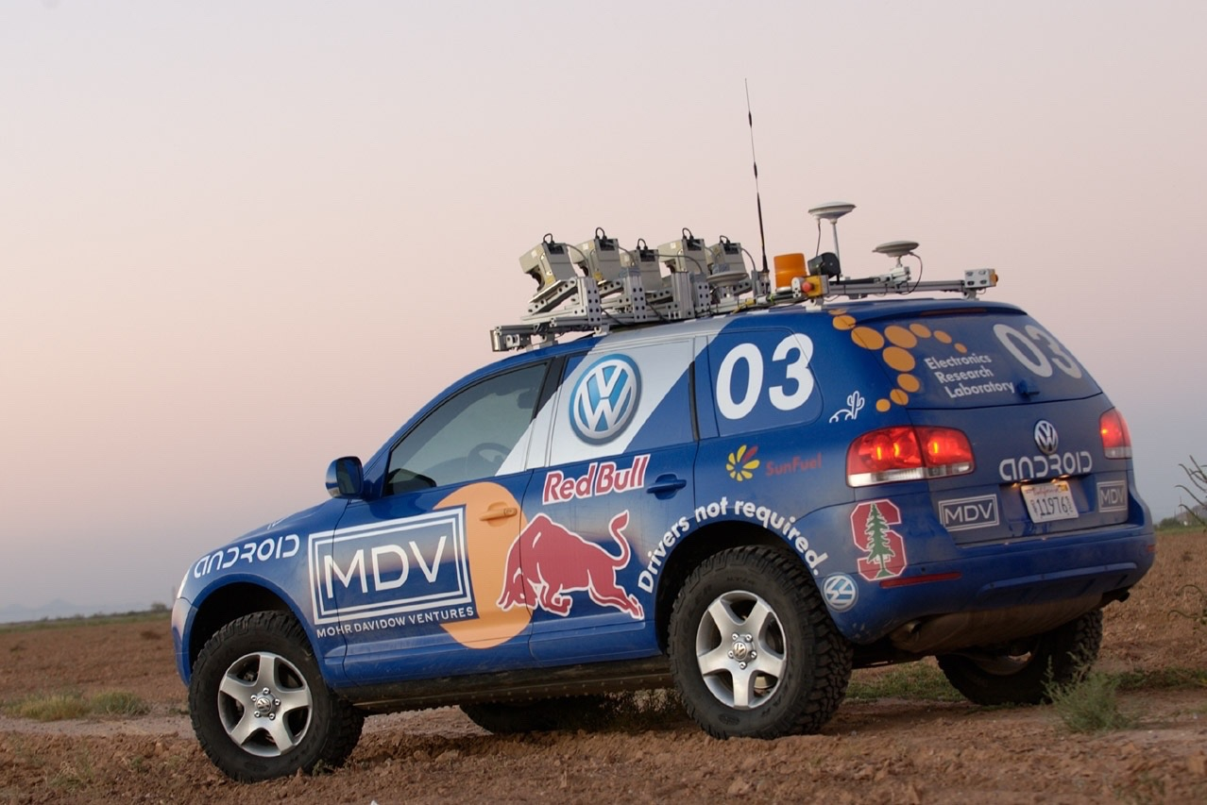
Now is the Time

Slide 85
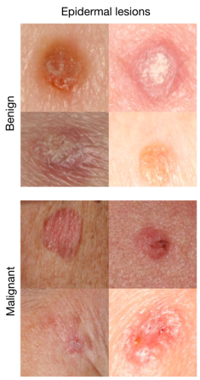
Where is this useful?
Now is the Time
A machine learning algorithm performs better than the best dermatologists.
Developed this year, at Stanford.
Esteva, Andre, et al. "Dermatologist-level classification of skin cancer with deep neural networks." Nature 542.7639 (2017): 115-118.
Esteva et al., Nature 2017.

Slide 86
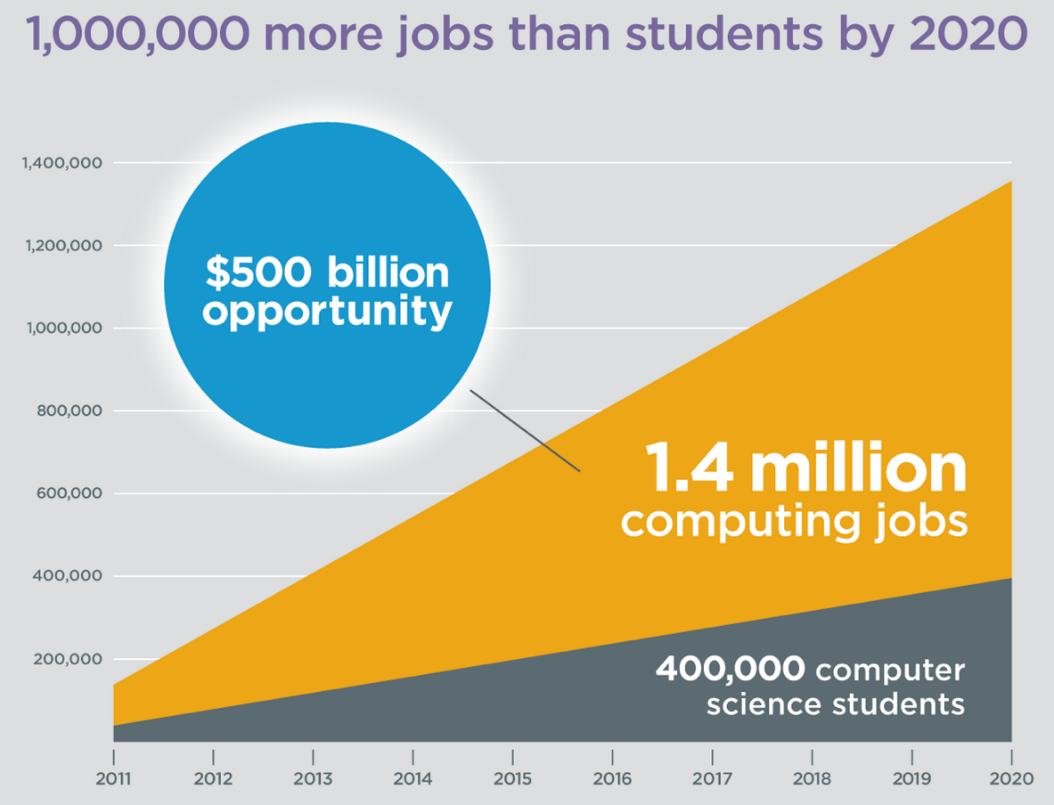
Oh and Its Useful
Code.org

Slide 87
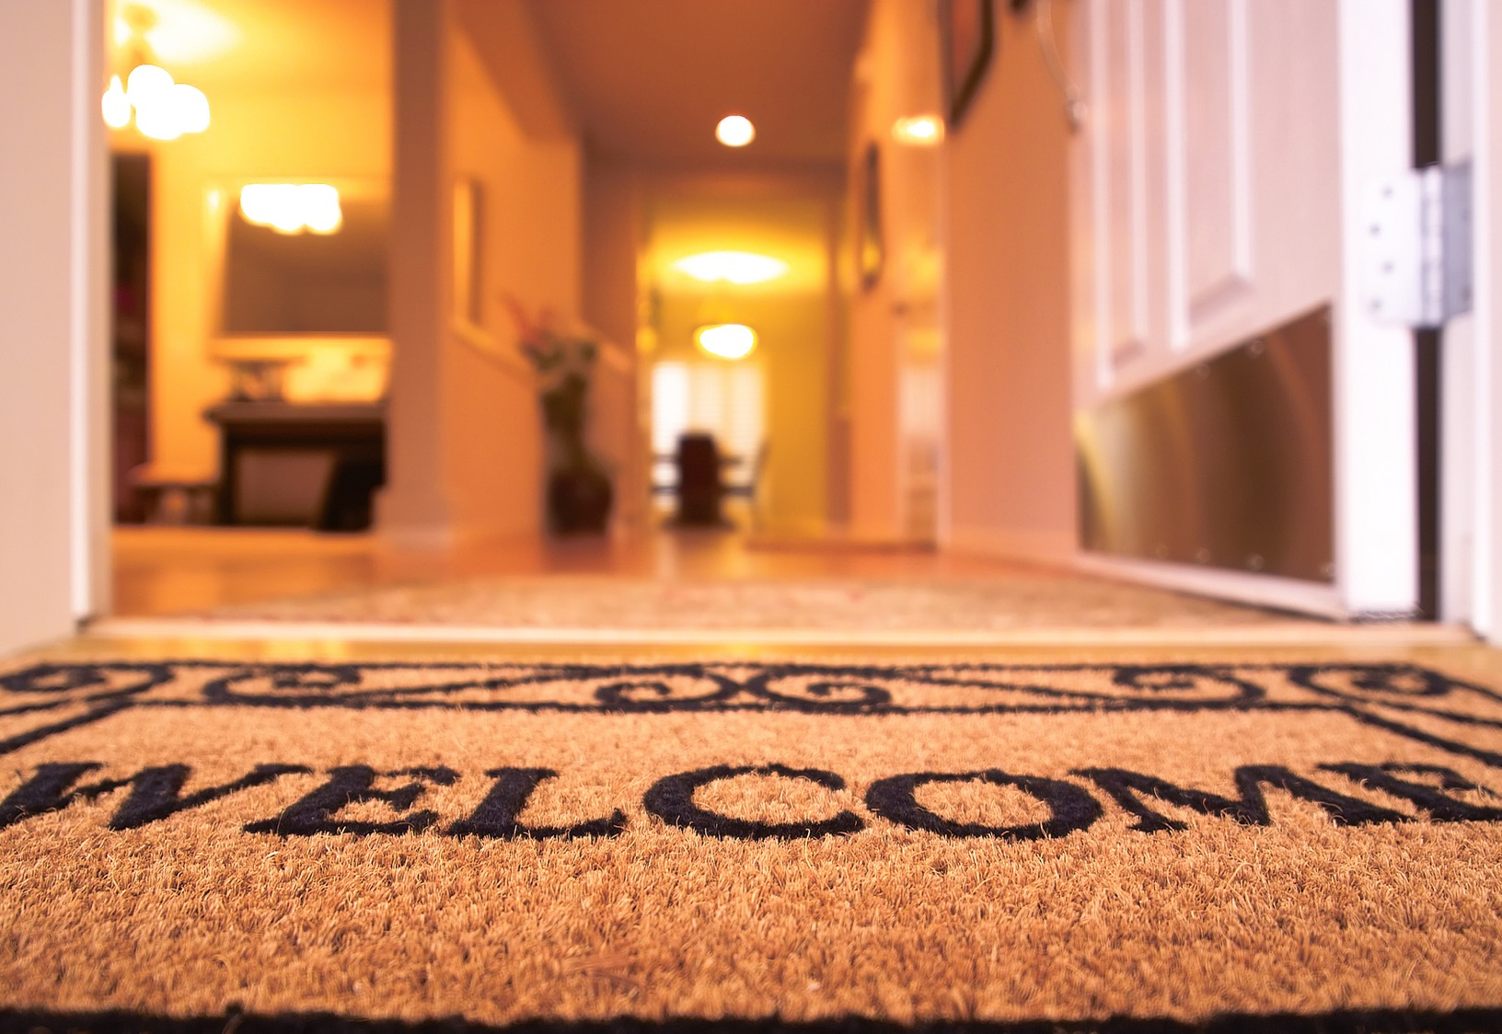
Everyone is Welcome
Notes:
One of my favorite things about programming is that we are all equal infront of Eclispe.
Eclipse does not care your ethnicity, gender, orientation.
That theme is part of the essence of CS106A.
Last night Oprah talked about the new day that is on the horizon! CS too is having a new day and it is very exciting future for the phenomenal women and men sitting in this classroom.

Slide 88
The End

Slide 89
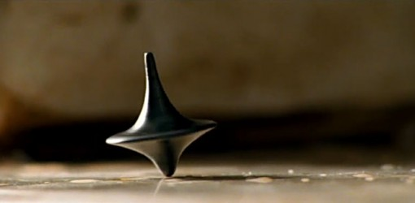
The End?

Slide 90
Who are you?

